Slide 1

AI-Powered Air Pollution Early Warning & Response System
TEAM NAMES : Data Mavericks
TEAM MEMBERS : Madhankumar T
Madhumitha B
Annamalai S

Slide 2
PROBLEM STATEMENT
Air Pollution Crisis:
Air pollution is a growing threat to public health, particularly affecting children, the elderly, and individuals with respiratory conditions. Schools and hospitals urgently need real-time air quality monitoring and predictive alerts to minimize health risks and ensure safer environments.
Current Challenges:
Traditional air monitoring systems are reactive rather than predictive, addressing pollution only after exposure has already occurred.
There is a lack of proactive measures to prevent harmful exposure, leaving vulnerable populations at risk.

Slide 3
PROPOSED SOLUTION
AI-Powered Monitoring & Alerts
Real-time air quality tracking using IoT sensors and AQI APIs for continuous monitoring.
AI-driven predictive analytics to forecast pollution trends 24-48 hours in advance.
Automated alerts via SMS and email to schools, hospitals, and government agencies for timely action.
Proactive recommendations, including traffic control measures and air purification activation, to minimize exposure.

Slide 4
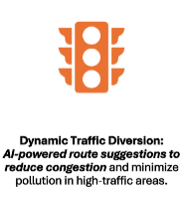
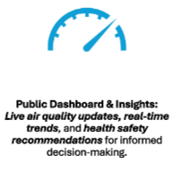
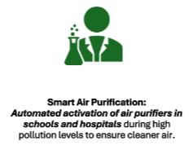
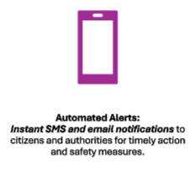
KEY FEATURES

Slide 5
TECHNOLOGY STACK
AI & ML Models:
LSTM, ARIMA, and XGBoost for accurate pollution forecasting and trend analysis.
Data Sources:
IoT-based air quality sensors for real-time data collection.
AQI APIs, Google Traffic API, and Weather APIs for comprehensive environmental insights.
Visualization & Alerts:
Power BI for interactive dashboards and real-time insights.
Twilio & Fast2SMS for instant alerts and notifications to users and authorities.
Cloud Deployment:
AWS / GCP for scalable, real-time processing and predictive analytics.

Slide 6
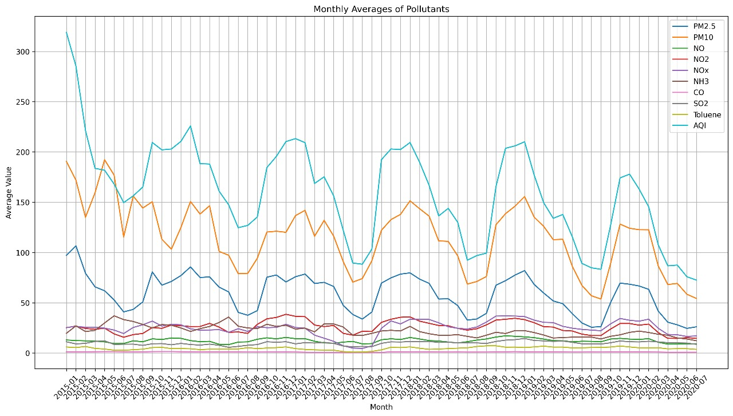
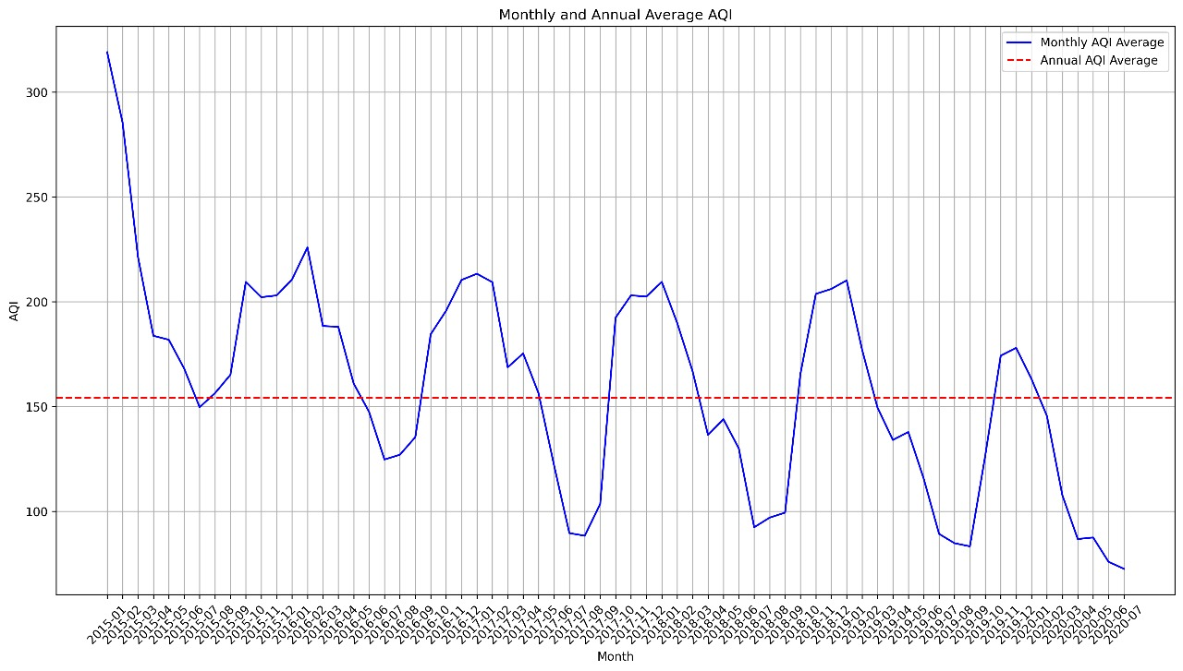
Air Quality Trends (2015–2020): Pollutant Levels & AQI Analysis
a) Monthly Averages of Pollutants
b) Monthly and Annual Average AQI

Slide 7
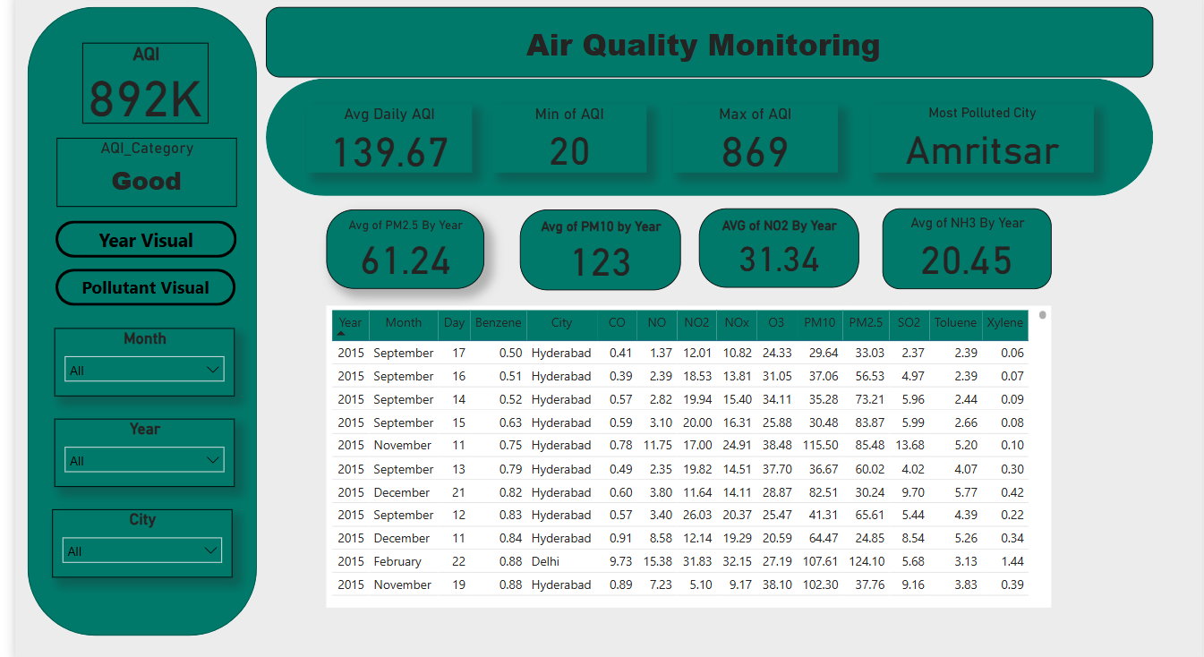
BASIC VISUALIZATION

Slide 8
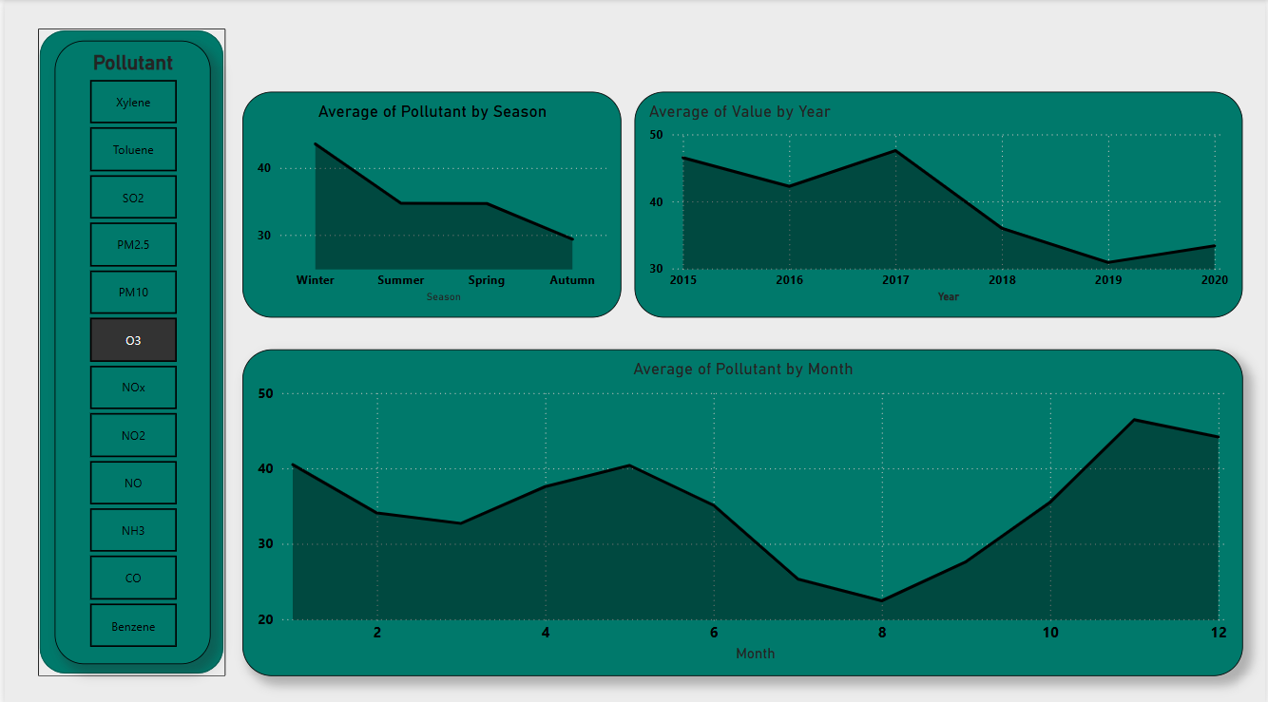

Slide 9
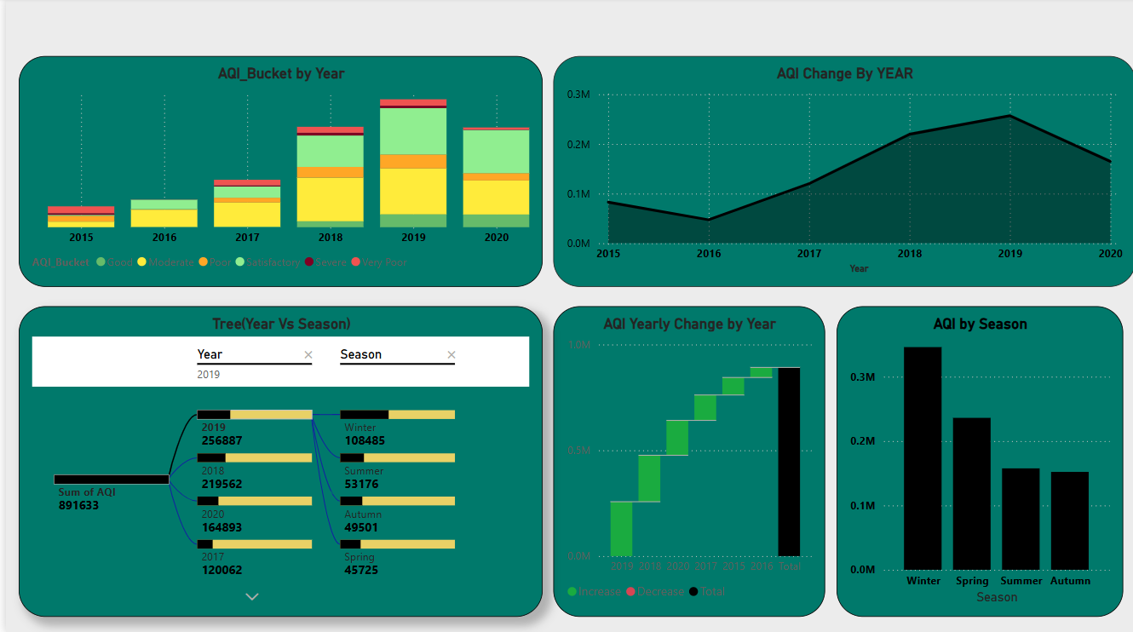

Slide 10

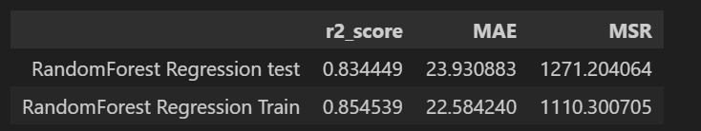
ML Model Performance Comparison
a) Linear Regression
b) Random Forest
c) Hyperparameter Tuning
The Random Forest model outperformed Linear Regression with a higher R² score and lower error;
Hyperparameter tuning further improved performance, achieving an best R² score.
Best R² Score: 0.8517
For more optimization, use LightGBM and XGBoost.

Slide 11
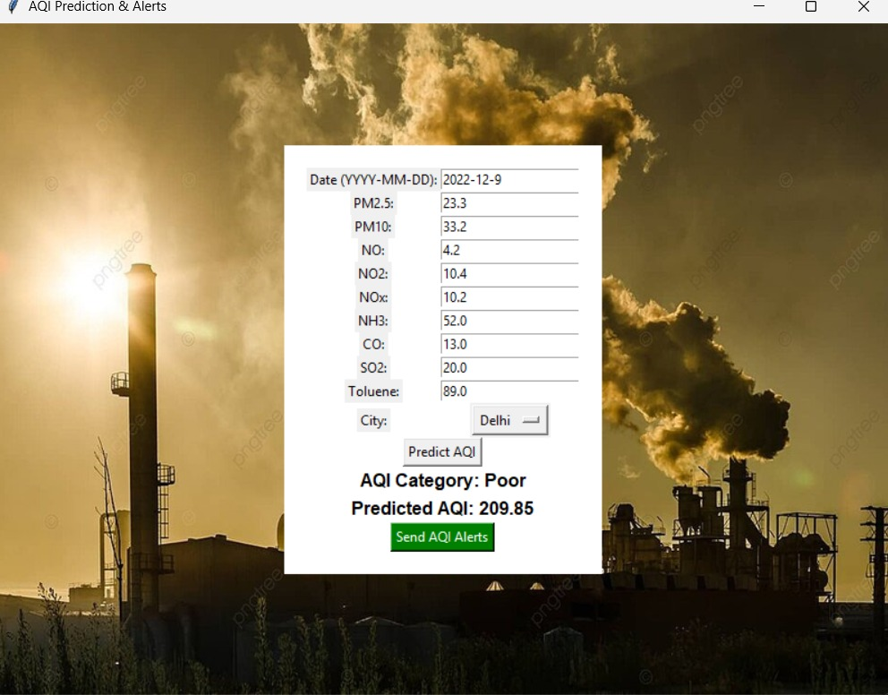
Real-Time Pollution Alerts: AQI Prediction
AQI Prediction & Alerts
Our innovative solution tracks air quality in Delhi, analyzing pollutants like PM2.5, PM10, NO2, NH3, and Toluene, and delivers instant alerts for poor AQI (201–300). On December 9, 2022, it identified an AQI of 209.85, categorized as ‘Poor,’ flagging high Toluene (89.0) and NH3 (52.0) to drive public health improvements.

Slide 12


BENEFITS
Health Protection: Minimizes pollution exposure risks, especially for children, the elderly, and individuals with respiratory conditions.
Proactive Decision-Making: Empowers authorities with predictive insights to take preventive actions before air quality deteriorates.
Policy Support: Aids governments in urban planning and pollution control, fostering smarter, cleaner cities.
Sustainable Development: Aligns with UN Sustainable Development Goals (SDG 3: Good Health & SDG 11: Sustainable Cities) for a healthier future.

Slide 13
FUTURE SCOPE
Scalability: Designed to expand across multiple cities and regions, adapting to diverse pollution challenges.
Smart City Integration: Seamlessly integrates with smart city infrastructure, enhancing urban sustainability.
Advanced Prediction Models: Future upgrades will incorporate deep learning techniques for even more accurate pollution forecasting.
Community Engagement: A public dashboard will promote awareness and participation, empowering citizens to take action.

Slide 14
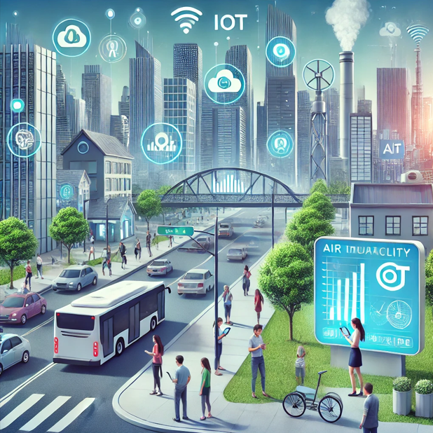
CONCLUSION
Comprehensive Solution: A powerful combination of real-time monitoring, predictive analytics, and automated alerts to combat air pollution.
Strong Value Proposition: Ensures safer environments for schools, hospitals, and communities by enabling proactive decision-making.
Scalable & Future-Ready: A data-driven, IoT-powered solution designed for smart cities, with the potential to expand globally.

